Slide 1
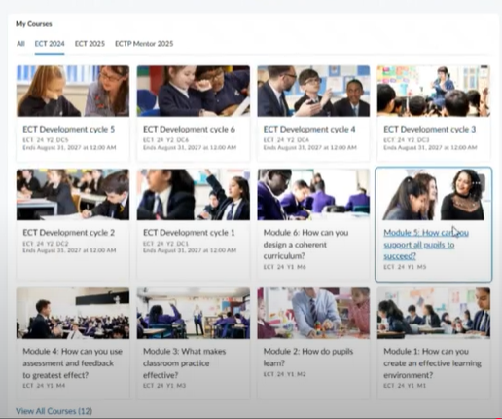
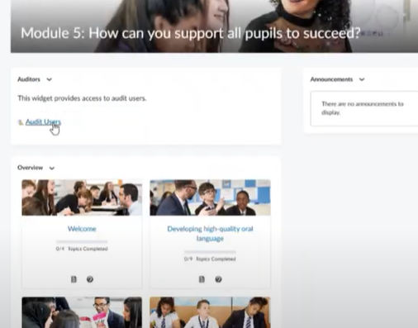
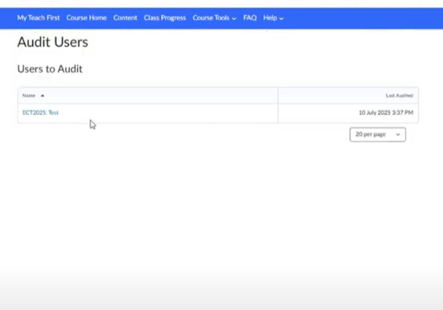
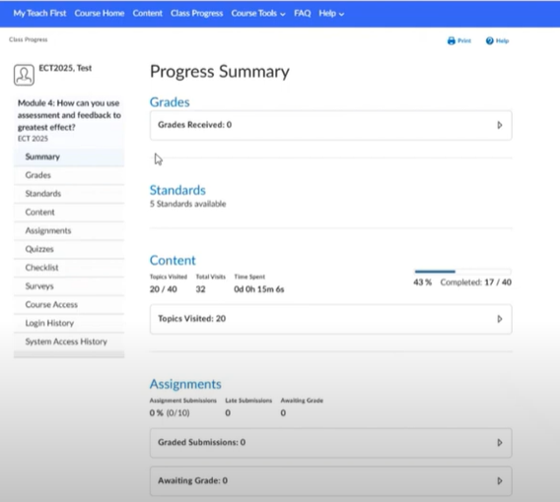
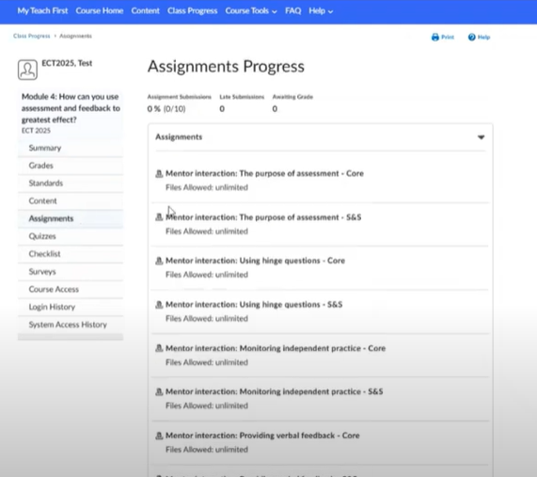
How to view ECT submissions
Select your ECT’s module
Select audit users
Select your ECT
Select the assignment
Assignments are not graded – they are to support ECT/Mentor discussion.
ECT’s only do core or summary and stretch submission – not both.
Select assignments

Slide 2

Guidance videos
Video links:
An overview of Brightspace as a mentor (includes how to view ECT submissions)
How to complete your diagnostic activity
Select link to watch guidance video

