Slide 1



Year 1 ECT Week 13 bulletin
w/b Monday 12th December 2022
ECF focus of the week:
Rest, relaxation and happy holidays
A message from the team:
First of all, well done! Well done for having completed what, for most of you, is your first term as an ECT. For those who started in April, well done for completing term 2! We are sure that it has been a very ‘full-on’ term, but hope that the past 13 weeks have been a rewarding experience. Whatever your plans are for the Christmas break, we hope that you have a well-earned rest and enjoy a happy and safe holiday season.
Progress Reviews: As you know, at the end of this term, your school will be completing a Progress Review for you on ECT Manager. Once the school has completed their report, it is electronically sent through to you for your comments. When writing your comments, please do include:
  What you have learnt (reflecting back over the term)
  What you feel you need to work on next (looking forward to the next term).
Please find overleaf an overview of the first half of the spring term. Please note that there will be no Week 14 bulletin, as Week 14 has been built in as a buffer week due to the different holiday dates that our schools have. Your next bulletin will be for Week 15, ie w/b 9th January 2023. This will be sent next week.
We also attach a copy of the updated Year 1 Primary and Secondary seminar organisation booklets. Attendance at seminars is both an entitlement and an expectation. The dates are published far in advance to enable you to make arrangements to attend. If, in exceptional circumstances, you are unable to attend a seminar, please ensure you contact both the person delivering the seminar and the Xavier central team - TeachingSchoolHub@xaviercet.org.uk. Seminar attendance is tracked through your completed evaluations. If you do not complete the seminar evaluation, you will not be recorded as having attended.
The Xavier team are eager to hear from you! Now that you have completed this term, we would be very grateful for any feedback you may have on how you are finding the programme, what has gone well, what would help you further etc. Please do take a moment to complete this very brief Google Form: Autumn Term Feedback. Thank you!
Teach First Early Career Teacher Winter Survey: Teach First are also keen to hear from you! Their ECT Winter Survey will soon be available on Brightspace for all ECTs who started in September 2022. The survey will be available from 16th December. The survey should be completed directly in Brightspace, as part of Module 3. Please note that ECTs will need to complete the survey (or opt out) in order to access the rest of the content for this module. Please be aware this only applies to September starters. Teach First will update you soon on how January and April starters can complete the survey. Teach First has scheduled announcement messages to appear on Brightspace from 12th December to alert you to the survey and has created a guide as to how to access the survey and release the rest of the content for the module. By completing the survey, you will be automatically entered into a draw to win one of two £50 Amazon vouchers.
How to Access and Submit the Survey on Brightspace - 2022 Cohort
From the team

Slide 2
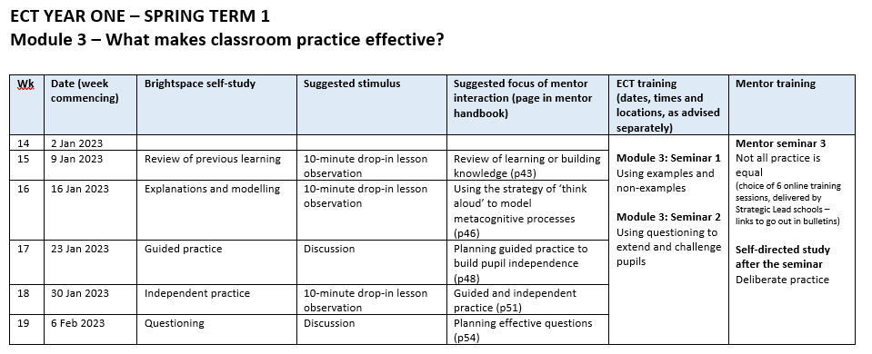


Year 1 ECT Week 13 bulletin (continued)
w/b Monday 12th December 2022
ECF focus of the week:
Rest, relaxation and happy holidays
Message to your mentor
Thank you for all of your hard work with all your ECTs this term. For some of you, the start of the term was challenging with many Brightspace issues. We are so grateful for all of your time and dedication and feel privileged to work with such a wonderful group of mentors across all of the different schools. May we wish you all a very safe and restful Christmas break and a Happy New Year and look forward to continuing to work with you in 2023.
Your mentor
Message to your induction tutor
End-of-term Progress Reviews and (for January 2022 starters) Assessments: Thank you to those who have completed their Progress Reviews and/or Assessments. We know that this is not an easy task at this time of year, when there is so much going on, but please rest assured that your ECTs really appreciate you celebrating their journey so far . If you are yet to start this task, please can I remind you of what we are looking for in these reports. The quality of written reports reflects on the school and reports should be robustly written.
  Please can you ensure that the statements are evaluative, ie you are making a judgement rather than describing. We are looking for the impact the ECTs’ progress has had on the learning.
  Judgements should be backed up with evidence (examples of good practice specific to the relevant Teachers’ Standard).
  Areas for development should be well-defined and provide direction and challenge.
ECTs leaving at the end of term: If you have an ECT leaving at the end of term for any reason, please let Sophie Hunter know, as she will need to change their progress review to an interim assessment. S.hunter@xaviercet.org.uk.
January 2023 ECT starters: Please note that there is a mandatory induction day for all January 2023 starters on Thursday 12th January 2023, which will be led by members of the Xavier ECF Central Team. On the day, new ECTs will complete the induction training programme, and cover the content of Modules 1 and 2. This will enable them to join the September 2022 training cohort for the start of Module 3. The induction day will not be recorded, so attendance is very important. Arrangements are as follows:
  Location: Salesian School, Guildford Road, Chertsey, Surrey KT16 9LU
  Time: 9.30 a.m. – 3.00 p.m.
  Lunch will be provided
  ECTs should bring a laptop, where possible.
Induction tutors

