Slide 1




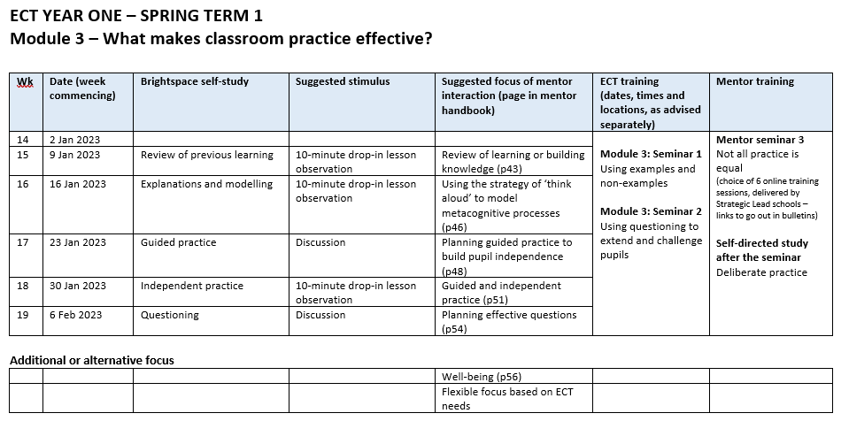

ECT Week 15 bulletin
w/b Monday 9th January 2023
ECF focus of the week:
Review of learning or building knowledge
A message from the team:
Welcome to the first bulletin of 2023! We hope you all had an enjoyable, safe and restful break and have returned with renewed energy for what we hope will be a really positive Spring term. Today’s bulletin is a long one, so please do take a moment to read it all.
Week 15 sees the start of Module 3 – What makes classroom practice effective? Although it went out in bulletin 13, please find below the overview of what you will be studying on Brightspace and working on with your mentor up until half-term
Your first face-to-face seminar for Module 3 takes place in Week 16, ie the week beginning Monday 16th January, and will focus on Using examples and non-examples.
Thank you to all those who have completed the Autumn Term Feedback Google form, sent out in the Week 13 bulletin. If you have done yet completed the form, please do take a moment to do so, by clicking on this link – Autumn Term Feedback. If the link does not automatically open, please try right-clicking on it and selecting 'open link'. Thank you!
At the start of Module 3 on Brightspace, you will be asked to complete the Teach First ECT Winter Survey. Please note that ECTs will need to complete the survey (or opt out) in order to access the rest of the content for this module. Please be aware this only applies to September 2022 starters. By completing the survey, you will be automatically entered into a draw to win one of two £50 Amazon vouchers. Please click on the link below to access Teach First’s guide:
How to Access and Submit the Survey on Brightspace - 2022 Cohort
From the team
ECTs’ self directed study: Module 3: What makes classroom practice effective?
In Week 15, you have a choice to either review your learning from Module 2, or focus on your use of explanations and modelling. You can, of course, always do both! The section on Brightspace entitled Review of previous learning only takes 15 minutes. The section entitled Explanations and modelling will take a maximum of 65 minutes to complete.
Self Directed Study

Slide 2


ECT Week 15 bulletin (continued)
w/b Monday 9th January 2023
ECF focus of the week:
Review of learning or building knowledge
Mentor interaction
In Week 15 you will have your usual weekly meeting with your mentor and they will also carry out a 10-minute drop-in observation.
For those of you focusing on reviewing your prior learning, your mentor might consider: (1) how you are implementing strategies that support the working memory, (2) did you break your explanation down into small enough steps?, (3) if you paired your explanation with a graphical representation, did it have the desired effect, and (4) was your worked example effective?
For those of you focusing on how you build your pupils’ knowledge, your mentor might consider: (1) whether or not you effectively modelled the concepts and provided enough concrete examples, (2) did you have a plan for how you were going to reduce the amount of support and guidance required by pupils?, (3) the extent to which you confidently faded out levels of support as pupils’ knowledge became more secure, and (4) how you adapt this model so that all learners have access to the support and guidance they need as long as it is required.
Your mentor
Additional CPD dates for spring and summer:
We are delighted to inform you that we have arranged for two additional CPD sessions to take place in the coming weeks. Please save the dates!
  Tuesday 28th March 2023
  The balance between teacher led and independent learning
  Guided and independent learning are both vital parts of the education process, and only by finding the right balance between the two can you help students move forward. Evidence shows that putting students at the centre of their learning increases development, intrinsic motivation and creativity. This CPD will explore ways to provide high-quality experiences for students, striking the balance between teacher-led and independent learning. The session will be run by an outstanding teacher and will provide a number of take-aways for you to use in the classroom.
  Tuesday 18th April 2023
  Understanding Dyslexia in the classroom
  This session will be led by Katrina Cochrane. Katrina is one of the UK's leading experts on dyslexia and learning difficulties, with senior teaching and management experience gained at major dyslexia charities, such as Dyslexia Action and the British Dyslexia Association. The author of several books and articles on dyslexia and the founder of Positive Dyslexia, a provider of training and assessment for individuals and companies, Katrina is passionate about helping teachers know how best to identify and meet the needs of their dyslexic pupils. Katrina is a warm and engaging presenter and we are confident that you will gain a great deal from attending the session. ( www.positivedyslexia.co.uk)

Slide 3



ECT Week 15 bulletin (continued)
w/b Monday 9th January 2023
ECF focus of the week:
Review of learning or building knowledge
ECTS, MENTORS AND INDUCTION TUTORS - HAVE YOUR SAY!
Focus groups – Monday 30th January – 4.00-5.00 p.m.
If you worked for the DfE and were asked to redesign the Early Career Framework, what would you keep and what would you change?
If you worked for Teach First and were responsible for redesigning their Brightspace (online) and face-to-face seminar materials, what would you keep and what would you change?
Are there any gaps in your training? If so, in what areas would you like additional CPD?
How helpful are the weekly bulletins you receive from the Xavier team?
Are there any other ways in which Xavier could support you?
As ECTs, mentors and induction tutors, you are uniquely placed to be able to comment on the content, organization and impact of the Early Career Framework in its current format. Your feedback is vital to the future success of the ECF, both locally and nationally. We therefore want to hear from you! On Monday 30th January, we will be holding focus groups, both online and in person, which you are warmly invited to participate in. The face-to-face session will be held at Holy Trinity School in Crawley. Teach First will be attending the online session. Please save the date! Full details will be in your Week 16 bullet.
Focus Groups
Message to your mentor
Welcome back to 2023!
In Week 15, your ECTs begin their study of Module 3 – What makes classroom practice effective? Their focus will either be on reviewing their prior learning or how they help their pupils to gradually build their knowledge. Please see page 43 of your mentor handbook for a full explanation.
In Week 15, you will undertake a 10-minute drop-in observation.
During your mentor meeting you may wish to discuss:
  Why is it important to teach information in small steps? What resources can you draw upon to support you in doing this?
  How can you make the steps in a process memorable for pupils? (for example, name them, use mnemonics, link to memorable stories)
  Why are worked and partially-completed examples useful? When might you use them?
Please ensure that your ECT has made plans to attend their first Module 3 face-to-face seminar in Week 16.
Please click on the following link to access the mentor familiarisation video for Week 16 Week 16 link
Mentor training will take place on the week beginning 23rd January. The links you require will be in our next bulletin.

Slide 4

ECT Week 15 bulletin (continued)
w/b Monday 9th January 2023
ECF focus of the week:
Review of learning or building knowledge
Message to your induction tutor
Welcome back to 2023!
Thank you to all those who completed last term’s Progress Reviews and/or Assessments by the given deadline. We appreciate the amount of work that this involved. There are still a number of reports outstanding. If you are unable to complete these by Friday 13th January at the latest, or require any additional support, please do get in touch with Sophie Hunter, who is the Xavier Appropriate Body lead. (s.hunter@xaviercet.org.uk)
Induction tutors
At Xavier Teach South East, we want to attract the very best candidates into the teaching profession. Do you know anyone who you feel would make a great teacher? We would love to train them!
Until the end of March 2023, Xavier Teach South East will pay you £100 (in gift vouchers) for every trainee you recommend, who is successfully recruited onto the ITT programme. There is no maximum amount, so the more people you help to recruit, the more gift vouchers you receive!
To secure your £100 per trainee, you just need you ask whoever you put forward to name you at interview.
Here's to attracting some fantastic candidates and championing our great profession! Please signpost your prospective candidates to tseinfo@xaviercet.org.uk.
Are your post-Christmas finances depleted?
Would £100+ help?

