Slide 1




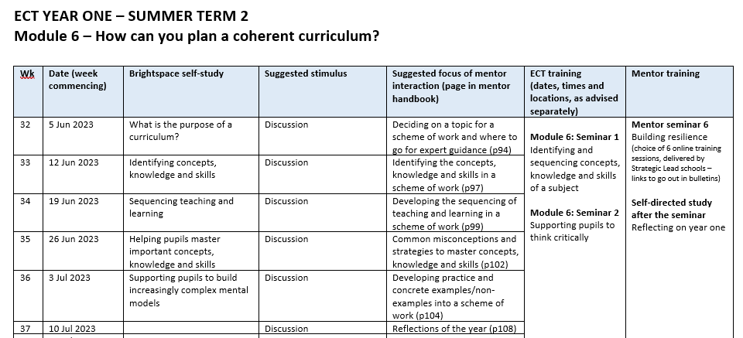
Year 1 ECT Week 33 bulletin
w/b Monday 12th June 2023
ECF focus of the week:
Identifying the concepts, knowledge and skills in a scheme of work
A message from the team
Welcome to Week 33 of the programme! Please find below an overview of this final half-term of Year 1.
In Week 33, you will all have the opportunity to attend the first seminar of Module 6, which focuses on identifying and sequencing concepts, knowledge and skills of a subject. As always, please do remember to compete your seminar evaluation. If, due to exceptional circumstances, you cannot attend the seminar, please also remember to email your induction tutor, seminar lead and attendance@xaviercet.org.uk and remember we offer seminars on various days to try and accommodate your attendance at this busy time of the year. Many thanks.
It is COMPETITION TIME! How would you like to win a voucher for afternoon tea for yourself and a colleague/friend? All you have to do is go to the Xavier Teaching School Hub’s Instagram page (@xaviertshub) and tell us about someone who has been a fantastic help to you during your first year as an ECT. This could be your mentor, induction tutor, another colleague, a family member – anyone, in fact, who has been a great support and why. You don’t have to name names, if you don’t want to, but tell us who it is and how they have helped you. The most compelling post will win a voucher for afternoon tea for you and your nominated person! Then like, comment and share the post so more ECTs can hear about your experience. Deadline for posts: 5 pm on Thursday 22nd June.
For those of you for whom this is term 3 of your ECT induction, you will have your first, formal end-of-year assessment. The window for schools to complete this assessment is from 30th June until 21st July 2023. Prior to your assessment taking place, there is a short form for you to complete, asking you to outline your progress against each of the Teachers’ Standards this year. Full details of the end-of-year assessment process can be found in the secure ECF Member Area of the Xavier website ECF Member Area. The email address you need to use to login is xavierecf@xavier.org.uk and the password is Xaviertsh. Once logged in, please navigate to the Induction Tutor Area and select the End of year assessments link, then open Guidance for ECT Formal Assessments.
As you know, the Teach First ECF programme had an Ofsted inspection in March. We are delighted to say that their outstanding report has now been published. Please do take a look! Teach First Ofsted Report
Do you know anyone who might want to be a teacher? Please see the last page of this bulletin for a fantastic opportunity to recommend a friend and earn yourself some money!
Team Message

Slide 2




Year 1 ECT Week 33 bulletin
w/b Monday 12th June 2023
ECF focus of the week:
Identifying the concepts, knowledge and skills in a scheme of work
Self-directed study: Module 6 – How can you plan a coherent curriculum?
In Week 33 you should complete the Module 6 section on Brightspace entitled Identifying concepts, knowledge and skills. This will take a maximum of 50 minutes.
In your online study you will consider the key knowledge, concepts and skills you will need to include within your chosen scheme of work. This includes any tier 2 or tier 3 vocabulary you feel needs to be shared.
Self-Directed Study
Mentor interaction
In Week 33, there is no scheduled observation. Rather, you will have a professional discussion with your mentor around the key knowledge, concepts and skills you have chosen to include in your scheme of work.
Your discussion might include:
  What big ideas of the subject or key concepts is this scheme building upon?
  What follows this scheme and what new content do pupils need for successful learning in the future?
  What concepts, knowledge and skills have you identified and why?
  What concepts, knowledge and skills did you decide not to include and why?
  What tier 2 and tier 3 vocabulary have you identified and why?
  How much time do you estimate will be needed to teach this scheme of work?
Mentors
Message for your mentor
In Week 33, as outlined above, your interaction with your ECT centres around the key knowledge, concepts and skills they have chosen to include in their scheme of work. Please refer to page 97 in your mentor handbook. Mentor video for Week 33 (6:44 mins)
A reminder to save the date: the next mentor training dates are during the w/c 19th June. There will be choice of training session available to you each night from 4pm. All links will be sent in next week's bulletin. The focus of the mentor training is building resilience in your ECT which is a valuable tool for mentors in their role.
Your mentor
Message for your induction lead
Secure members area - Just a reminder that all end-of-term assessment documentation is available in the secure members area of our website including a step-by-step approach to assessment and the ECT self-reflection form.
  Xavier Teaching School Hub - Secure Area (xaviercet.org.uk)
  Username – xavierecf@xavier.org.uk
  Password – Xaviertsh
Final assessments – A gentle reminder that if, by this time in the term, you have any doubts that any of your ECTs will be able to successfully complete induction, the deadline for communicating this to us was half term. In order for us to support you as a school and your ECT, please contact s.hunter@xaviercet.org.uk this week.
September registrations - If you have ECTs who need registering for September 2023, please Register your interest here. We understand that at this point you might not know how many ECTs you may have in September. At this point, please just give your best estimate, which will inform Xavier’s planning for 2023-24. The form can be completed again later in the year once you are certain of your numbers.
Induction tutors

Slide 3
Year 1 ECT Week 33 bulletin
w/b Monday 12th June 2023
ECF focus of the week:
Identifying the concepts, knowledge and skills in a scheme of work
Message for your induction lead (continued)
DfE Portal - In advance of the DfE portal opening for new September registrations. The DfE have asked us to communicate to schools the need for induction tutors' details to be up to date and accurate. If you are leaving your post or are new to role, please register as the induction tutor for your school on the DfE portal. All communication from the DfE and Teach First will be delivered to the details registered on the DfE portal. To ensure we capture all the information required in the most accurate manner could we please ask you to complete the ECF programme member changes form linked here. This will advise us of all the changes required and enable us to make the necessary amendments.
WE ARE GROWING! - We are actively looking for another Primary delivery partner in or around the Chertsey area. If you have staff in your school who would be able to deliver high-quality seminar training to ECTs, and your school would like to join our delivery partner team, please contact Charlotte Carr on c.carr@xaviercet.org.uk
We are currently working on our Induction Tutor Checklist for September, if there is anything that you currently do and think would benefit all, please let Sophie Hunter know (s.hunter@xaviercet.org.uk).
ECT Manager clean up - Please can you log on and check that the list of tutors/induction tutors registered for your school is up-to-date. Some schools have tutors registered who have left the school etc. Please note that each school should only have one induction tutor. Could you please also check that the email addresses of all your ECTs are their professional (school) addresses, rather than their personal ones. Please also ensure your Headteacher’s name and information is current. Please update and check all the details on ECT Manager in preparation for the new year. Many thanks. https://xaviertsh.ectmanager.com
Mentor funding - We have had some enquiries from induction tutors asking us to clarify the mentor funding for next year. As mentioned in last week's bulletins, mentors who will complete the two-year mentor programme this July will be classed as trained and are therefore not eligible to receive funding if they mentor again. Please see the document below, which explains the funding implications in full. If you would like to talk to a member of the team please contact us at TeachingSchoolHub@xaviercet.org.uk.
  Backfill payments for time off timetable for early career framework (ECF) mentor training (national roll-out) conditions of grant - GOV.UK (www.gov.uk)
  https://www.gov.uk/government/publications/backfill-payments-for-time-off-timetable-for-early-career-framework-ecf-mentor-training-national-roll-out/backfill-payments-for-time-off-timetable-for-early-career-framework-ecf-mentor-training-national-roll-out
Induction tutors

Slide 4

Year 1 ECT Week 33 bulletin
w/b Monday 12th June 2023
ECF focus of the week:
Identifying the concepts, knowledge and skills in a scheme of work
Do you know anyone who would make a great teacher?
Would you like to earn £50 or more?
In conjunction with Eteach, Xavier Teach SouthEast are holding a coffee morning for graduates (or soon-to-be graduates!) who might be interested in joining our outstanding initial teacher training programme in September. All are welcome. Please pass on the following link to those who may wish to attend https://forms.office.com/e/YSRVhewSN4.
If we offer a training place to anyone you have referred to us, and they accept, you will receive a £50 voucher of your choice. All your friend/family member/colleague has to do is to mention your name at interview. It is £50 per successful candidate, so please do spread the word!
10.00 a.m. – 12.00 noon
Thursday 15th June
Eteach, Arlington Square, Downshire Way, Bracknell RG12 1WA

