Slide 1




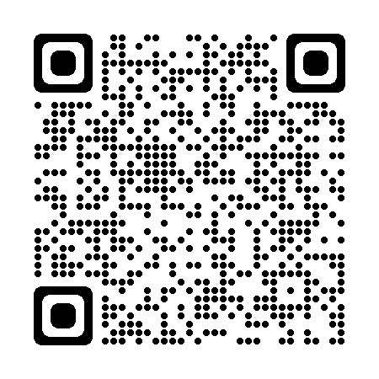




Year 1 April starter ECT Week 5 bulletin
w/b Monday 3rd October 2022
ECF focus of the week:
Well-being
A message from the team:
Welcome to your Week 5 bulletin!
We hope that those of you who attended the Module 1 Seminar 1 face-to-face training seminar in the past week enjoyed the session and, in particular, the opportunity to network with other ECTs. Please do remember to complete the seminar evaluation (via the QR code below), if you have not already done so. Your attendance at the seminar is recorded once the evaluation has been completed. If, for any reason, you did not attend the seminar and have not yet informed the Xavier team of the reason for your absence, please do make contact with Kate du Toit (k.dutoit@xaviercet.org.uk). Many thanks.
From the team
ECTs’ self - directed study: Module 1 How can you create an effective learning environment?
In Week 5 there is no specified Brightspace study, so this provides a good opportunity for you to catch up, if necessary, or look ahead.
Self-directed study
Mentor interaction
In Week 5 you will have your usual weekly meeting with your mentor. Please do remember to either upload your Mentor Meeting record onto Brightspace or keep a hard copy in a folder, if you prefer.
In Week 5, the focus is on your well-being. As a teacher, nothing is more important than taking care of all aspects of your health. Please find attached a copy of the slides from the well-being session which formed part of your induction. To view the notes for each slide, click on View, then Notes Page. The slides remind us of the concepts of threat, drive and recovery and of the importance of having a personal action plan to safeguard your physical and mental health.
Your mentor
Message to your mentor
For mentor guidance on this week’s ECT focus, please refer to page 35 in your Mentor Handbook. As a mentor, you play a vital role in helping to support your ECT in their efforts to keep safe and well.
Save the date: the next mentor training session is w/b 28th November. All sessions are online and we will send out links to you in the preceding week’s bulletin, so that you can choose to attend whichever session is most convenient for you.
Mentors
Message to your induction tutor
The second training session for induction tutors will focus on assessment. This is scheduled to take place from 4:00-5:00 pm on Monday 10th October. The Zoom meeting ID is 892 1968 7279, passcode 881875, or please click on the following link: Induction tutor training - 10th October 2022.
Induction tutors

