Slide 1

Your wellbeing​
Notes:
00:03 – 00:04 (1 minute)
Explain: It can be challenging for teachers to strike a good work-life balance.
Teacher wellbeing has been acknowledged, by the government, the DfE, and Ofsted, as something that needs to be “tackled” and there are research-informed initiatives that are making a difference to day-to-day classroom practices.
While workload is linked with wellbeing, minimising workload is not the focus of the session (it deserves a session all to itself). The purpose of this session is to explore ways you can support your own wellbeing and why it is important to do so.
You also have access to the ‘My Wellbeing’ course that is available on Brightspace, which has been designed by Teach First in collaboration with The People Project psychologists Dr Lindsay Joyce and Cornelia Lucey. There is some overlap between this session and the wellbeing course. However, the wellbeing course goes into greater depth, extending on learning from today’s session, as well as providing new learning and different actionable strategies.
Link to next slide: With this in mind, let’s look at the objectives of the session.

Slide 2
Related ECF statements
Learn that… | Learn how to…
Standard 8 – Fulfil wider professional responsibilities
8.1 Effective professional development is likely to be sustained over time, involve expert support or coaching and opportunities for collaboration. | Manage work and wellbeing by: 8p Protecting time for rest and recovery
Notes:
00:04 – 00:05 (<1 minute)
Explain: Engaging in professional development and the support your mentor can give you is a requirement of the ECF and is very closely linked with your own wellbeing. Understanding how to manage your work and wellbeing is vital for you.
Please take a few moments to read and understand these ECF standards.
Link to next slide: Why is teacher wellbeing so important?

Slide 3
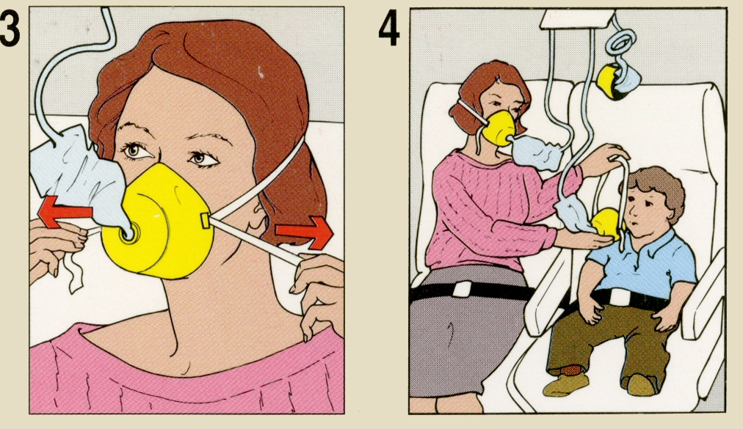
The importance of wellbeing
"Average levels of teacher wellbeing within schools has been found to be linked to pupil performance, as assessed by SATs and value-added measures."
(Briner & Dewberry, 2007)
Put your own mask on first
Notes:
00:05 – 00:06 (1 minute)
Key Learning Point (KLP) : For ECTs to know that poor teacher wellbeing has been linked with reduced motivation and academic outcomes in pupils, so it is important that teachers look after their wellbeing.
Explain: If you have feelings of poor wellbeing and are subsequently not performing at your best, then you will be less able to offer support to others. The analogy of applying your own oxygen mask on first is well known one, but it encapsulates why it is important to pay attention to your own wellbeing first, and consider what the consequences might be for the pupils you teach if you don’t.
There is a growing body of research that links teacher wellbeing with pupils’ academic outcomes. [Reveal] Take a few moments to read this quote from just one of the papers linking teacher wellbeing with pupil outcomes. (Briner, R., & Dewberry, C, 2007)
Link to next slide: Considering this link, we are going to now look at what is happening in the mind and body of a teacher who is experiencing poor wellbeing and the impact this can have on their decisions, actions, and emotions.
Research reference:
Briner, R., & Dewberry, C. (2007). Staff well-being is key to school success. In London Worklife Support Ltd. http://www.teachertoolkit.co.uk/wp-content/uploads/2014/07/5902birkbeckwbperfsummaryfinal.pdf

Slide 4
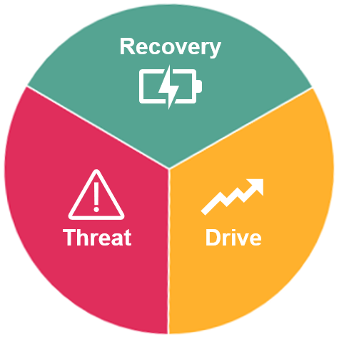

Threat, drive and recovery
Exercise
Mindfulness
Socialising
Escapism
Energy recuperation
Calm
Safe
Energy demanding
Negative emotions
Inhibits cognition
Behaviour incident
Deadlines
Unexpected meeting
Energy demanding
Motivated
Focused
Productive
Possibility of overdrive
Overdrive:
Extra hours
Sacrificing sleep
Sacrificing diet
Sacrificing social life
Notes:
00:06 – 00:11 (5 minutes)
KLP (slides 7-12): For ECTs to begin to understand the threat, drive and recovery systems that govern our emotional responses and what can happen to feelings of wellbeing if ‘recovery’ is not prioritised.
Explain: Governing our everyday decisions, actions and mood is the ‘emotional regulation system’ within our brains. This system is in fact made up of three systems that are in a state of constant flux depending on the information we are receiving from our environment. You have some space in the induction workbook to make any notes if you wish.
Each of the systems has a key biological function.
Threat:
The threat system alerts us to dangers and prepares us to ‘fight or flight’ (think Caveman encountering a Sabretooth Tiger).
We don’t often encounter Sabretooth Tigers in present day, but for teachers the threat system can be tiggered by anything that our brain perceives as threatening [Reveal] e.g., behavioural incidents, observations, tense interactions with colleagues, unexpected meetings etc.
This system causes the release of adrenaline which activates our physiological ‘fight or flight’ response (increased heart rate & breathing rate, nausea, sweating, hyper alertness)
If the brain consistently perceives threats within the environment, this system can mean that a person experiences a maintained state of hyper alertness/ anxiety and experiences poorer cognitive functions.
The threat system is very energy demanding, impairs cognitive abilities, and is not a pleasant state to be in for a sustained period of time.
Drive:
The biological purpose of drive is to motivate us to pursue the things that increase our chances of survival (think Caveman hunting a mammoth)
In modern times we can think of it as driving us to the pursuit of success & productivity - E.g., effective lesson planning, resource design, CPD, relationship building etc.
It is easy for teachers to slip into ‘overdrive’ [Reveal]. Work longer hours, sacrificing sleep, taking on more than they can comfortably handle etc.
The drive system gives dopamine release (the pleasure hormone). Which is why we feel happy when we experience success. But it can be addictive and can lead to overdrive.
The drive system is also very energy demanding.
Recovery:
Recovery is where we recuperate energy expended during the threat and drive states.
It allows the body time to recover and stabilise our cortisol (stress hormone) levels in order for us to perform better.
Activities that can support recovery include [Reveal] exercise, escapism (e.g., watching TV), meeting friends and family etc.
Recovery activities are unique to the individual. We will look at this in more detail shortly.
It is important that the ‘threat’ and ‘drive’ systems don’t dominate as this can harm our wellbeing.
There is more about the emotional regulation system and the importance of recovery in the ‘My Wellbeing’ course, onto which all ECTs and mentors are enrolled and can be accessed on Brightspace.
Link to next slide: What can a teacher’s threat, drive recovery system look like over the course of a week?
Research reference:
The People Project: https://www.the-people-project.com/

Slide 5
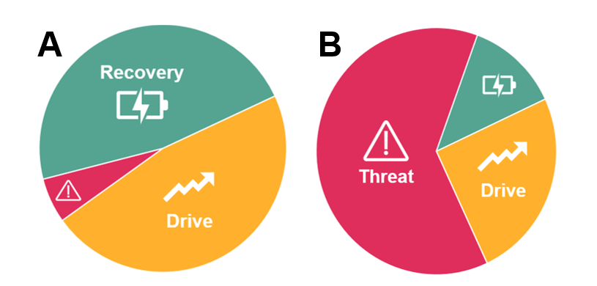
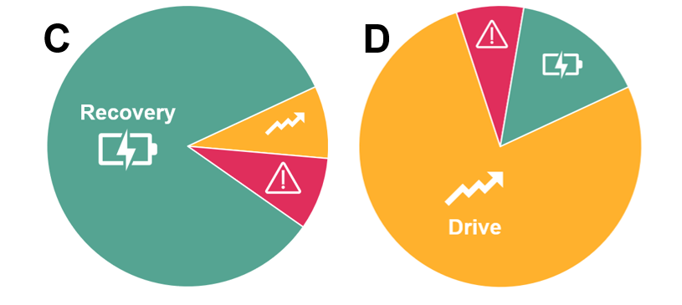
Threat, drive and recovery
Aleena is a teacher in her second year of teaching.
Over the weekend:
Determined to have a good week, Aleena spends almost all her weekend doing school work, taking little time to recover from the previous week.
Which pie chart do you think best represents Aleena’s current state?
Notes:
00:11 – 00:12 (1 minute)
Explain: Please take 30 seconds to read Aleena’s scenario before you share your thoughts.
Activity:
Ask ECTs to consider and respond to the question. You may wish to consider how you gather responses here.
For this activity (slides 8-12) you may wish to capture ECT’s answers through discussion with a nearby colleague, the raising of their hand, or by sharing of answers using whiteboards if available.
Feedback:
Allow for a few answers before indicating that Aleena is at point D – All work, little rest.
A – Productive, balanced and sustainable
B – Unproductive, unsustainable, unpleasant
C – Unproductive; appropriate during holidays or after period of overdrive.
D – Overdrive; productive but unsustainable. Occasionally necessary in short bursts.
Link to next slide: What does Aleena’s threat, drive recovery system look like on the Monday?

Slide 6
Threat, drive and recovery
Aleena is a teacher in her second year of teaching.
Monday:
Aleena gets into work early to organise her classroom because she was too tired to do it last Friday. She works hard the rest of the day taking only 10 minutes to eat her lunch.
Which pie chart do you think best represents Aleena’s current state?
Notes:
00:12 – 00:13 (1 minute)
Explain:
Please take 30 seconds to read Aleena’s scenario for Monday before you share your thoughts.
Feedback:
Allow for a few answers before indicating that Aleena is at point D – All work, little rest.
A – Productive, balanced and sustainable
B – Unproductive, unsustainable, unpleasant
C – Unproductive; appropriate during holidays or after period of overdrive.
D – Overdrive; productive but unsustainable. Occasionally necessary in short bursts.
Link to next slide: What does Aleena’s threat, drive recovery system look like on the Wednesday?

Slide 7
Threat, drive and recovery
Aleena is a teacher in her second year of teaching.
Wednesday:
Aleena gets an email from her Head of Department asking for a “quick chat” the next morning. Aleena gets anxious and can’t focus on the books she is trying to mark.
Which pie chart do you think best represents Aleena’s current state?
Notes:
00:13 – 00:14 (1 minute)
Explain:
Please take 30 seconds to read Aleena’s scenario on the Wednesday before you share your thoughts.
Feedback:
Allow for a few answers before indicating that Aleena is at point B – an irrational response to a probably innocent email.
A – Productive, balanced and sustainable
B – Unproductive, unsustainable, unpleasant
C – Unproductive; appropriate during holidays or after period of overdrive.
D – Overdrive; productive but unsustainable. Occasionally necessary in short bursts.
Link to next slide: What does Aleena’s threat, drive recovery system look like on the Friday?

Slide 8
Threat, drive and recovery
Aleena is a teacher in her second year of teaching.
Friday:
By the end of school on Friday Aleena feels too tired to organise her classroom. Anxious to have a good week next week, she decides to work extra hard over the weekend…
Which pie chart do you think best represents Aleena’s current state?
Notes:
00:14 – 00:15 (1 minute)
Explain:
Please take 30 seconds to read Aleena’s scenario on the Friday before you share your thoughts.
Feedback:
Allow for a few answers before indicating that Aleena is at point B – she is anxious about the next week.
A – Productive, balanced and sustainable
B – Unproductive, unsustainable, unpleasant
C – Unproductive; appropriate during holidays or after period of overdrive.
D – Overdrive; productive but unsustainable. Occasionally necessary in short bursts.
Link to next slide: It is clear that Aleena is stuck in a Threat-Drive loop. What could Aleena do to help herself?

Slide 9
Threat, drive and recovery
What one piece of advice would you give to Aleena?
Threat-Drive Loop
Who could Aleena go to for support?
Notes:
00:15 – 00:16 (1 minute)
Explain:
What Aleena is unaware of is that she is living in a threat-drive loop [Reveal].
This is when a person spends most of their time moving between high adrenaline threat and the dopamine fuelled drive systems. Existing in this loop for too long without recovery will lead to feelings of poor wellbeing and eventually burnout. Sometimes we must choose to prioritise recovery by ‘putting our own masks on first’.
Ask:
What one piece of advice would you give to Aleena? [Reveal]
Who would you suggest Aleena goes to for support/advice? [Reveal]
If you feel there is time you could ask for responses here. If not you may wish to refer back to sessions from earlier on in the day when ECTs have considered how important their relationship is with their mentor and how this will be a key source of support.
Link to next slide: Teachers often report finding it difficult to find the time to prioritise recovery, so how can it be built into the small windows of everyday/week?

Slide 10

Prioritising recovery
What does recovery look like for you?
  Escapism
  Socialising
  Mindfulness
  Sleep
  Nutrition
  Exercise
  Creativity
  Safety & familiarity
What could you do?
Notes:
https://www.youtube.com/watch?v=S_zGIlqLZlk (ECT Induction 5 – Video 1)
00:16 – 00:23 (7 minutes)
KLP (slides 12-14): There are many things we could do to improve our wellbeing. We need to consider as many as possible before we decide what we will do.
Explain:
It can be challenging to prioritise recovery. It can lead to feelings of guilt (e.g., the idea that we aren’t spending our time well, or that we are being lazy).
Humans also have an innate ‘negativity bias’ – we are more likely to focus on ‘bad’ feelings (e.g., guilt).
It is important to take time to reflect on what recovery looks like for us and how it can be built into our daily routine.
We need to be mindful of recovery habits that will not support wellbeing – for example, overeating, drinking too much, spending beyond means, overexercising etc.
We will watch a video then spend 2 minutes in small groups brainstorming potential actions that could be done to improve recovery.
Play the video.
In your groups, list as many potential actions as possible in the relevant section of your workbook. Keep asking yourselves “What else could I do?”
Ask:
What could you do?
When could you do it?
What else?
Ask ECTs to add any personal anecdotes and strategies to the relevant section of their workbook for this session.
Link to next slide: What have we covered this session?

Slide 11
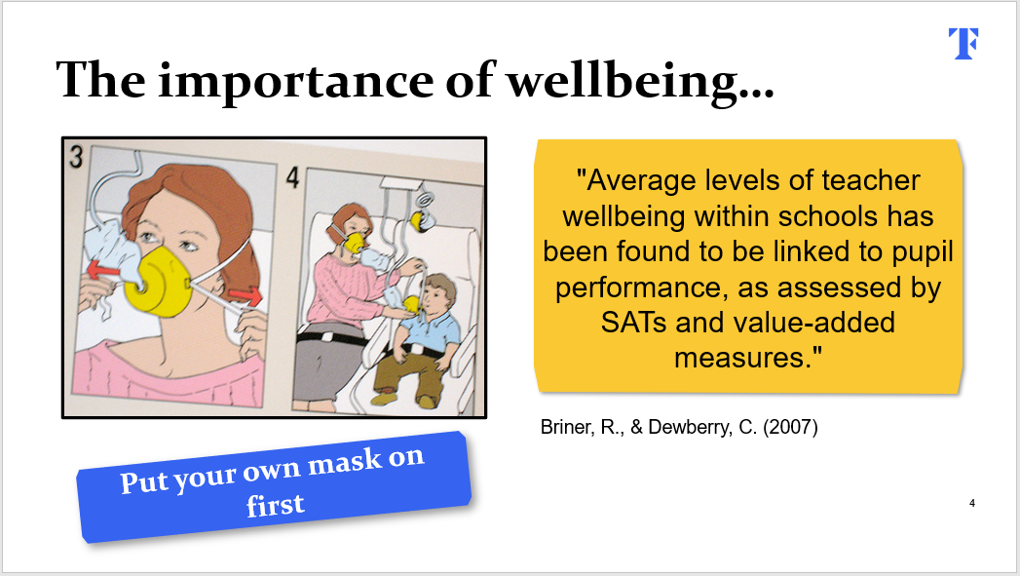
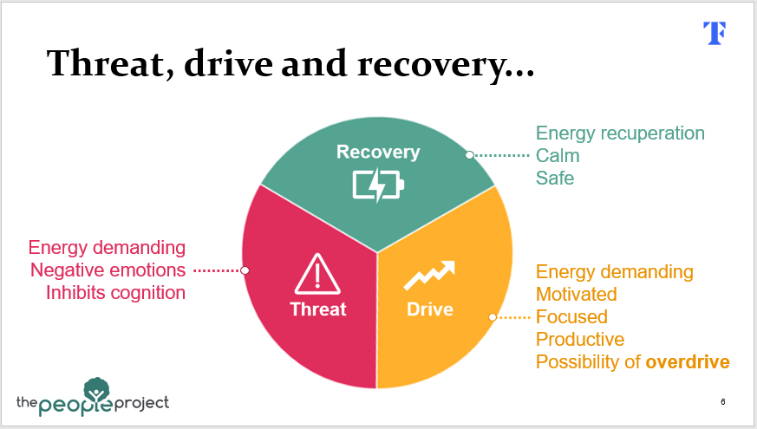
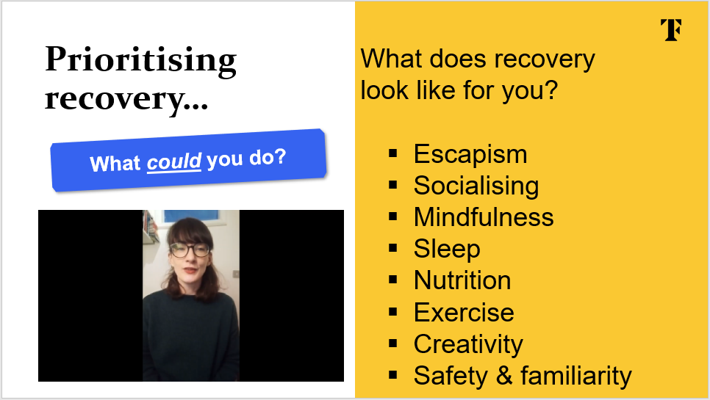
Session summary
1
2
3
Notes:
00:23 – 00:24 (1 minute)
Explain: We have explored upon some important realities to consider as a teacher.
[Reveal] We covered the link between pupil outcome and teacher wellbeing.
[Reveal] We covered the threat, drive and recovery systems and the importance of prioritising recovery to avoid threat-drive loops.
[Reveal] We considered ways we could potentially prioritise our recovery.
Link to next slide: Now it is time to commit to something that you will do to prioritise your ‘recovery’ in order to support your wellbeing.

Slide 12
Personal action plan
What will you do?
5 minutes
Which of the ideas listed above seem the most appropriate for me?
What specific actions will I take?
When will I start?
The first 3 questions…
Notes:
00:24 – 00:30 (6 minutes)
Explain:
Read through the questions in your Induction workbook then take a minute to look through the best practice exemplar on page 21.
[Reveal] The questions that are displayed on the slide are the first three question in your Induction workbook. Aim to get at least these questions completed in the time available. It may be useful to take this away with you and complete it in your own time.
Pause
Now, complete your personal action plan, where you will commit to something that you will do to prioritise your ‘recovery’ to support your wellbeing.
As this is a personal reflection, please do answer the questions independently as each of us will require different actions in order to prioritise wellbeing.
You may want to share this with your mentor when you next meet with them.
Link to next slide: Thank you

Slide 13
References
Briner, R., & Dewberry, C. (2007). Staff well-being is key to school success. In London Worklife Support Ltd.
The People Project. Available from: https://www.the-people-project.com/
Notes:
For reference

